Slide 1
04
Bitmaps and Fonts

Slide 2
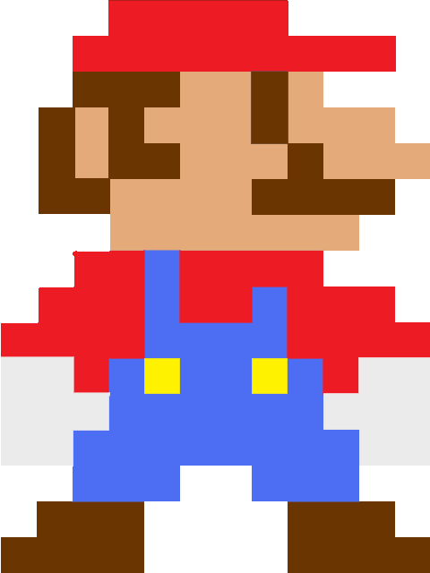

What is a bitmap?
(Computer imagery terms):
A rectangular collection of pixel data, arranged to store an image.

Slide 3
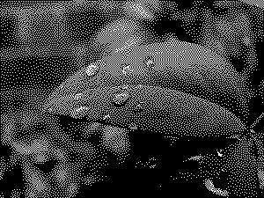
What is a bitmap
Origin of term originally meant a collection of ones and zeros arranged in a 2D array.
e.g. a binary image:

Slide 4
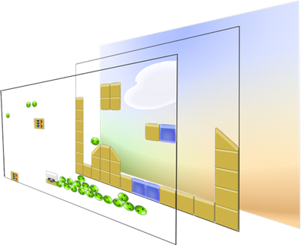
2D Games
By layering bitmaps, a 2D “world” can be built up

Slide 5
Sprites
Small bitmaps placed in a rendered scene.

Slide 6
Sprites
Small bitmaps placed in a rendered scene.
Often used represent objects and characters, render effects, display overlays, etc

Slide 7
Sprites
Small bitmaps placed in a rendered scene.
Often used represent objects and characters, render effects, display overlays, etc
Sprites are usually animated, using a sequence of bitmaps shown in order to create illusion of movement

Slide 8
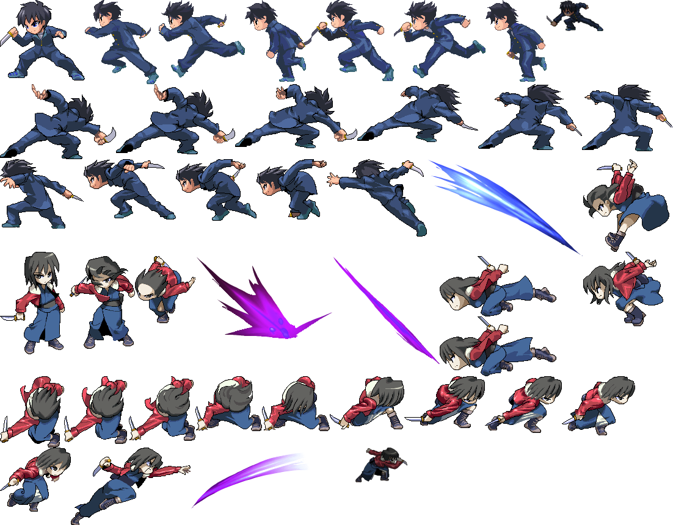

Slide 9
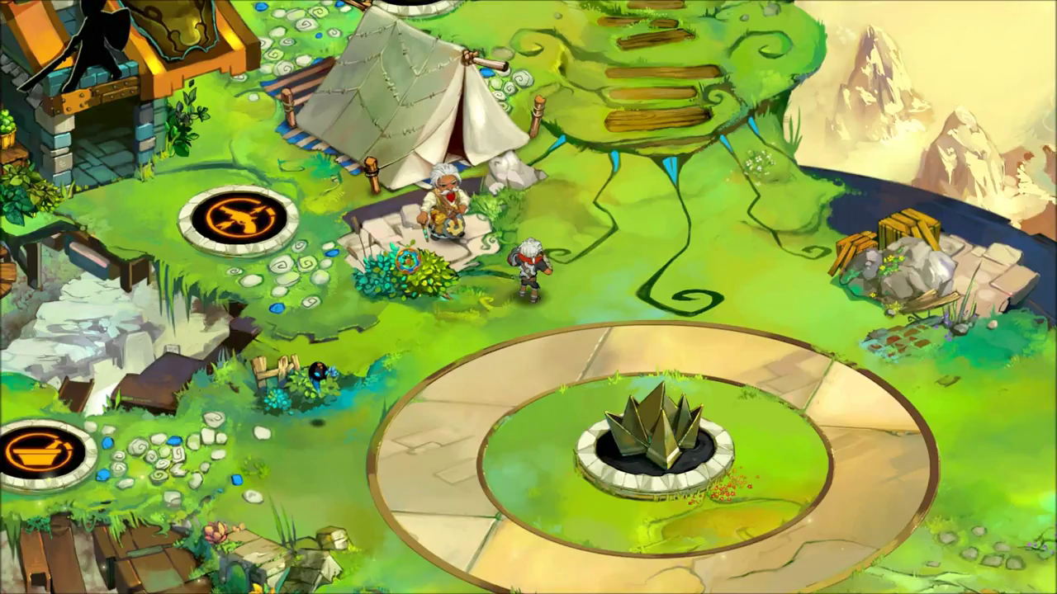
Sprites
Technique (and 2D games) still alive and kicking today
Bastion – Supergiant Games
http://supergiantgames.com/index.php/media/

Slide 10
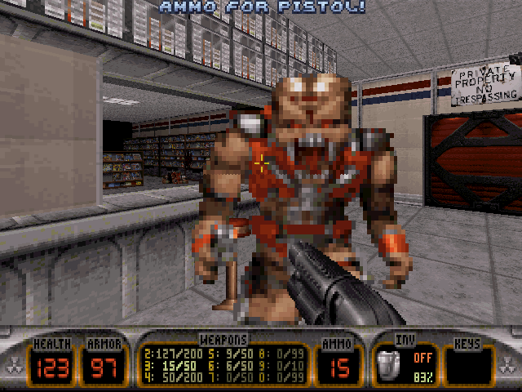
Sprites
Sprites can also be found in 3D environments using a technique called “billboarding”

Slide 11
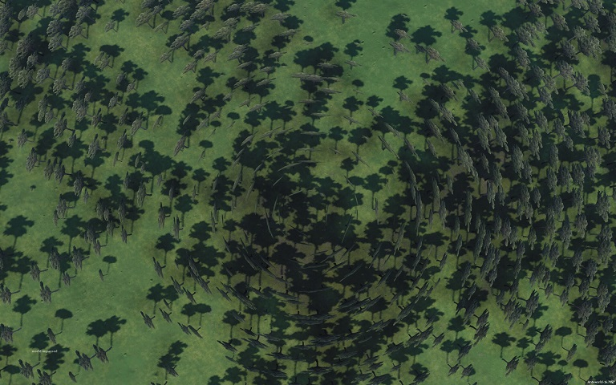
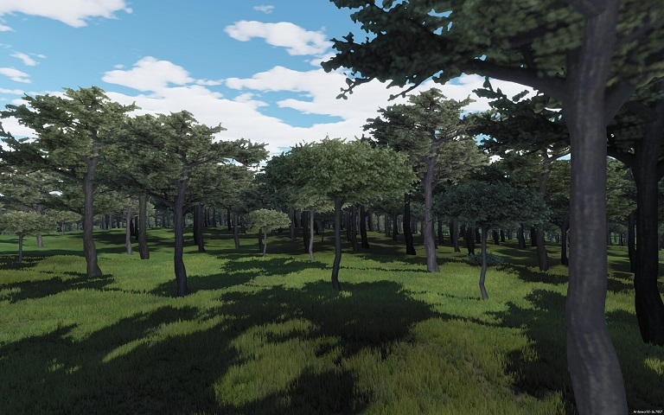
Sprites (Billboards)
Billboards are angled to be always perpendicular to the camera.
Most frequently used nowadays for spot VFX (e.g. flame, dust, explosion particles)

Slide 12
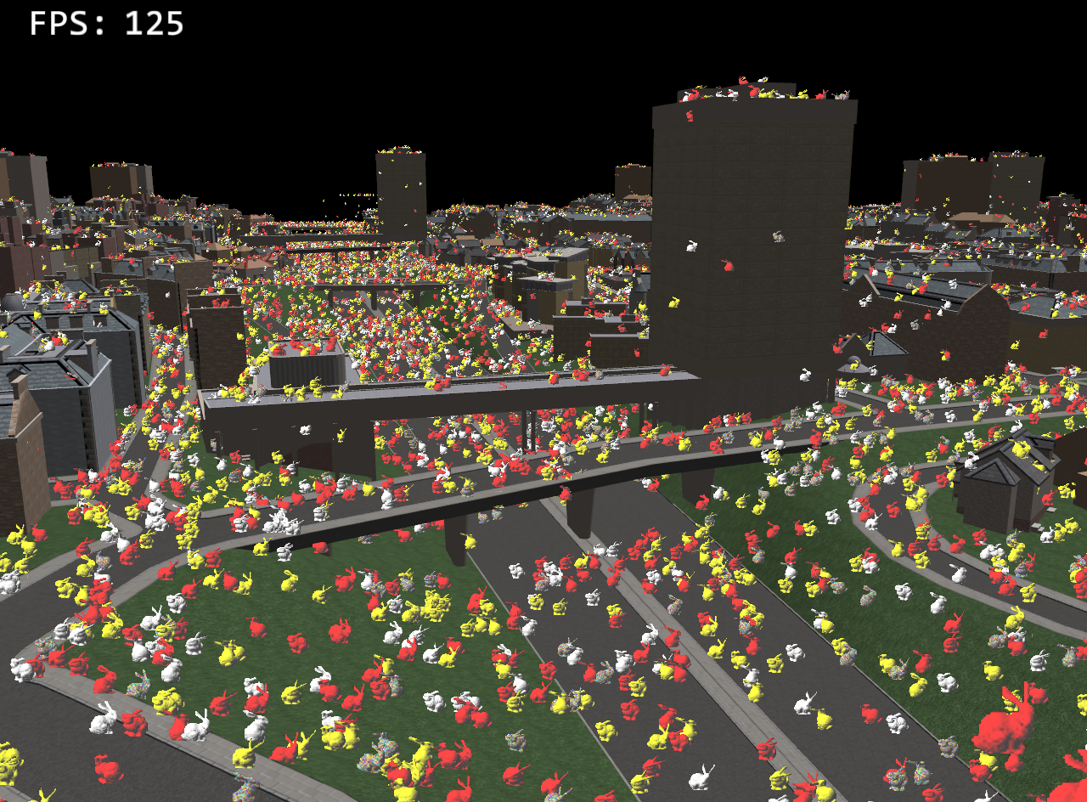
Sprites
Although some games still use them heavily
“A Game In 2 Weeks”
http://dailly.blogspot.co.uk/2011/12/game-in-2-weeks.html

Slide 13
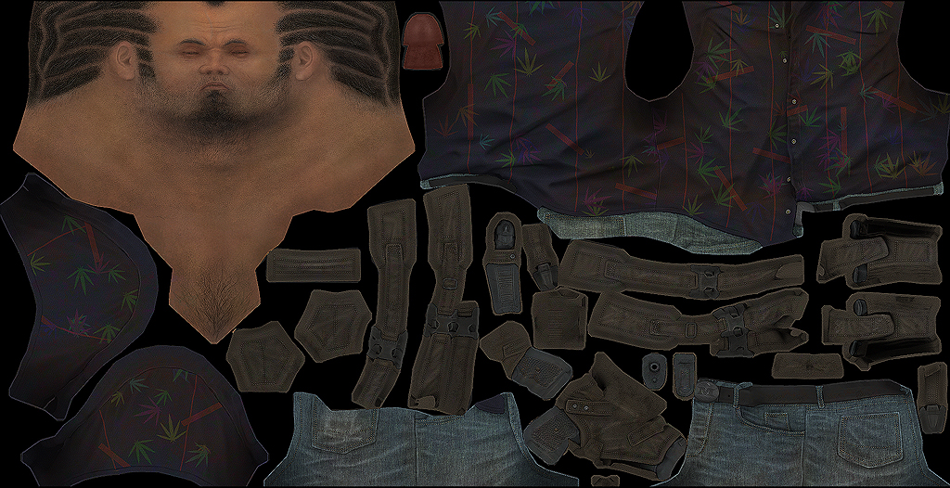
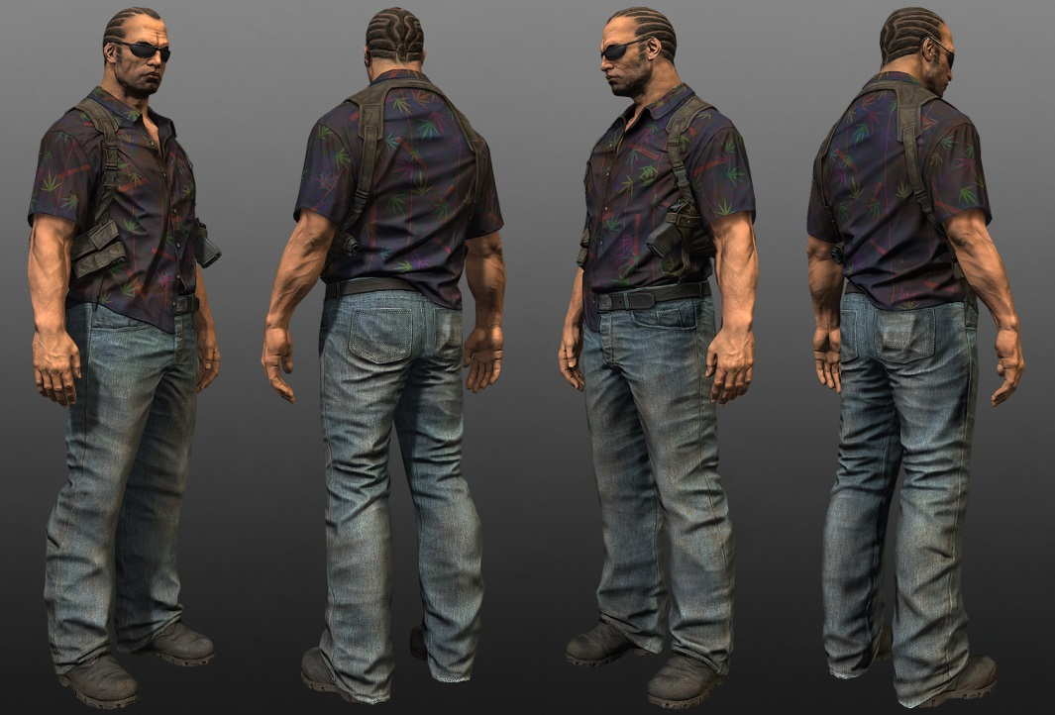
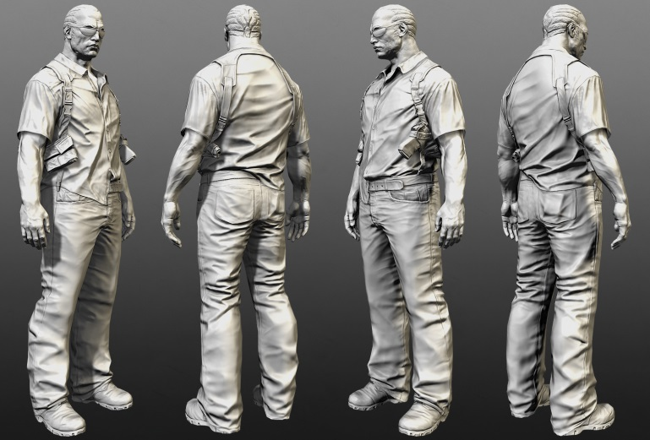
Textures
Bitmaps are also used in 3D rendering, as textures wrapped around 3D meshes
Street Cop Workflow – Mashru Mishu
http://en.9jcg.com/comm_pages/blog_content-art-180.htm

Slide 14
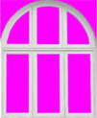
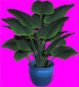
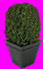
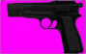
Transparent Pixels
Before “alpha” was invented, pixels had to be ignored by hand.
“Transparency” colour was explicitly stated:
Any colour can be set as transparency, but usually something easily identifiable is used.

Slide 15
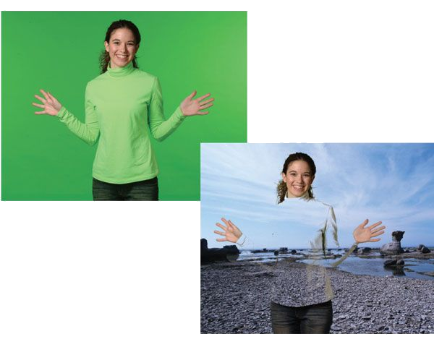
Transparent Pixels
Same technique used for ChromaKey effects (blue screen/green screen) in TV and movies

Slide 16
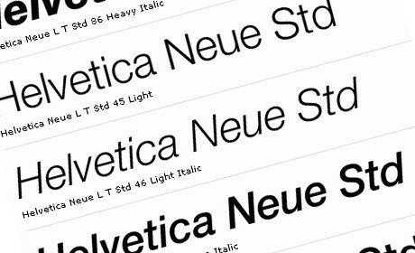
Fonts
A size, weight and style of a typeface.
Typefaces are made up of a range of fonts that share a design.

Slide 17
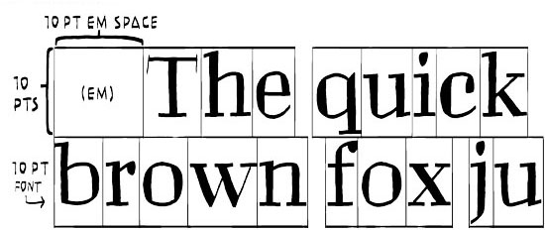
Font Point
Point size is the vertical measurement of a font’s lettering.
There are 72.272 points in one inch.
Therefore a 36 point font is roughly 0.5in (1.27cm) in height.

Slide 18
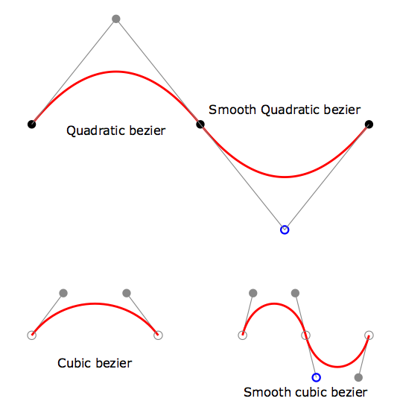
True-Type fonts
TTF fonts are Outline fonts, built mathematically using straight-line segments and Bezier curve segments.
TTF curves are quadratic beziers, described by 2 “end” points and a “control” point.
Simpler to calculate than more common cubic beziers.

Slide 19
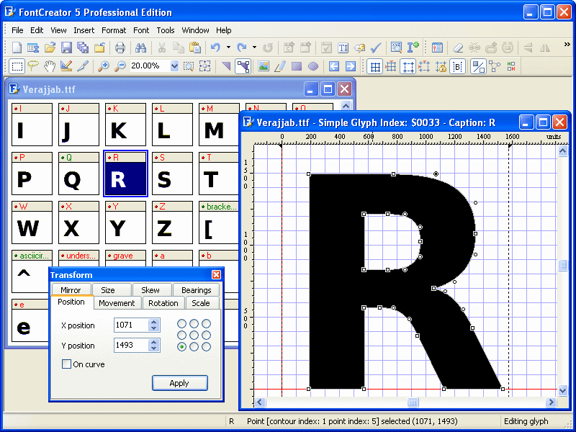
True-Type fonts
Calculating TrueType Fonts mathematically (rather than relying on bitmaps), means lettering can be scaled to any size with no loss of fidelity.

Slide 20
Questions?

Slide 21
Transparent Pixels
Movie too big for SOL
Click on the link below if you want to view it.
Sin City Show Reel (David Ridlen, CG Supervisor)
https://www.youtube.com/watch?v=6UlbpwZ-cEQ

